Slide 1
Despliegue continuo de tu infraestructura cloud con Azure ARM templates
Iván Chesa / Luis Mañez

Slide 2
Notes:
Carlos

Slide 3
Notes:
Carlos

Slide 4

Iván “la barba” Chesa
Dedicated to Azure and SharePoint development in the last years and certified by Microsoft as MCSE: Cloud Platform and Infrastructure.
https://www.linkedin.com/in/iv%C3%A1n-chesa-4284b7133

Slide 5

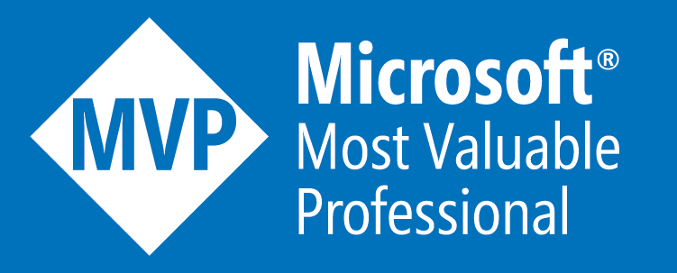
Luis Mañez
SharePoint and Cloud solutions architect en ClearPeople.
Office Development MVP. Cerca de 15 años trabajando con tecnologías Microsoft. SharePoint MCPD y Certified specialist in Developing Azure. OfficeDev PnP Key contributor.
https://twitter.com/luismanez
https://github.com/luismanez
https://medium.com/inherits-cloud
https://www.linkedin.com/in/luismanez/

Slide 6
Azure ARM benefits

Slide 7
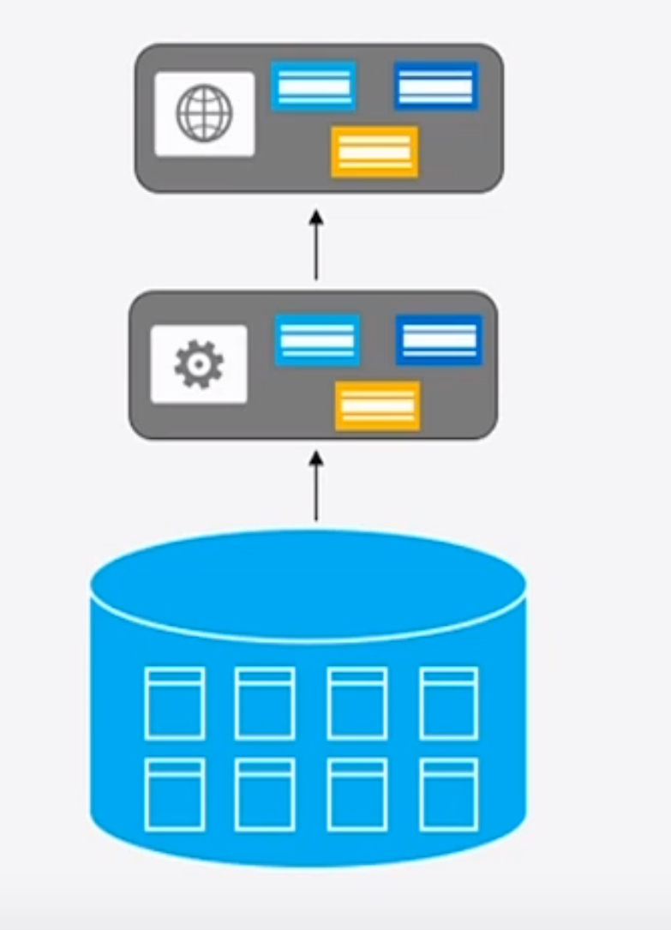
Monolithic Applications

Slide 8
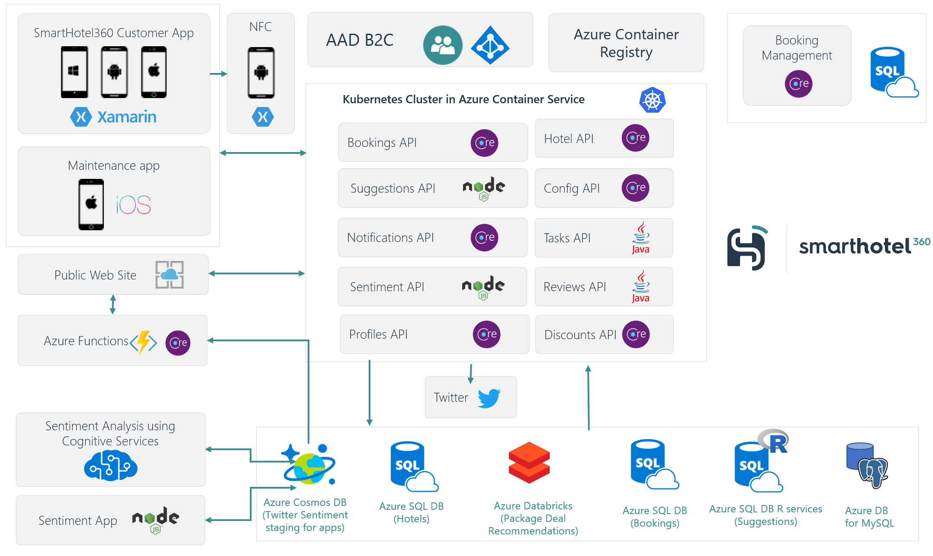
Microservices Applications

Slide 9
… and per environment
DEV
QA
PROD

Slide 10

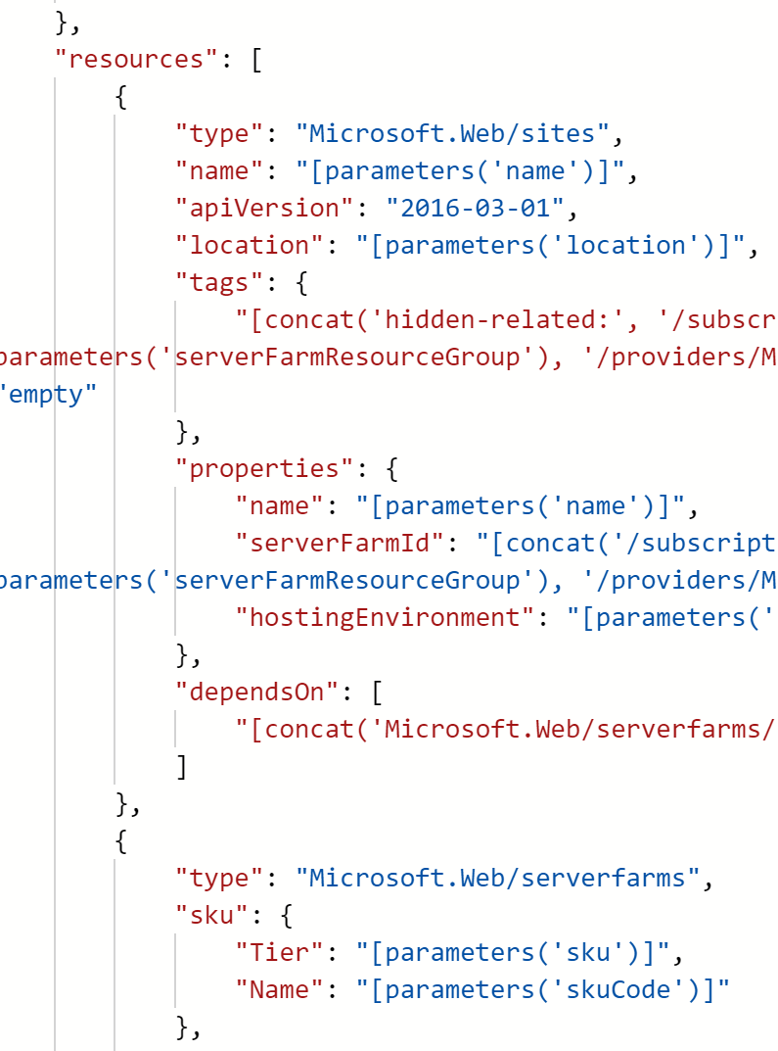
ARM Templates to rescue
PROD
QA
DEV

Slide 11
Azure ARM template anatomy

Slide 12
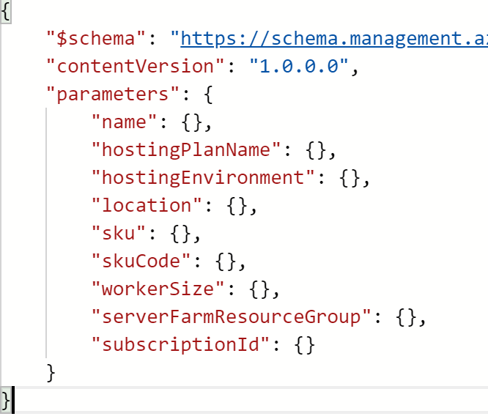
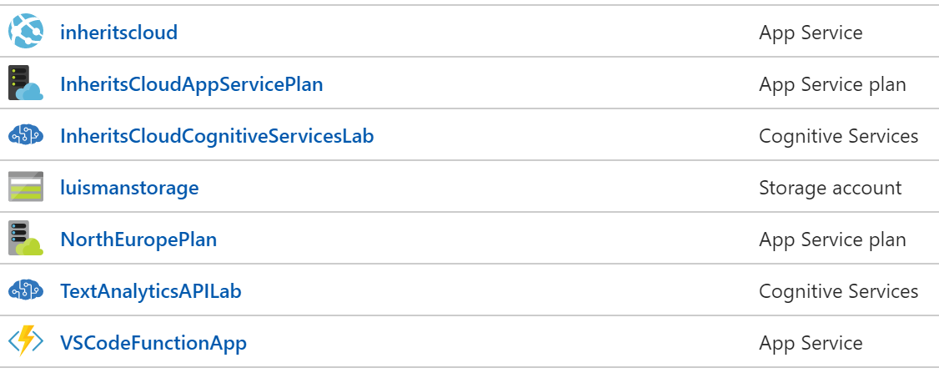
ARM Template Anatomy
Template JSON
Parameters JSON
Power Shell
CLI
API

Slide 13
Azure ARM template demo

